Slide 1




Hackatom 2026
Egypt · Team Pantomath
HORUS
Hivemind for Onboard Radiological Understanding & Sorting

Slide 2

One mislabeled drum is a regulatory event.
01
A nuclear facility produces tens of thousands of waste drums per year. Most are easy — VLLW gloves, LLW filters. The expensive ones are the edge cases: a low-activity-looking container that hides an actinide spike. Mislabel it as LLW, and you've put intermediate-level waste on the wrong shelf. The cost is regulatory, dosimetric, and human.*
Today this work runs on slow, dose-limited human inspectors and isolated robotic scanners that don't talk to each other. Every new edge case has to be re-learned, drum by drum, person by person. The fleet has no memory.
The problem
* IAEA GSG-1 classes: VLLW / LLW / ILW / HLW. An ILW drum sitting in an LLW bay is a dose event for any worker on inspection rounds.

Slide 3
A living, thinking hivemind for radioactive waste.
02
The vision
We turn waste management and decontamination into a coordinated organism. Robotic arms, mobile scanners, fixed lab instruments — all of them sense, all of them act, all of them feed one central memory.
Field instruments train against the lab. The lab pushes corrections back to the field in seconds. The first agent to see a new failure mode immunizes the entire fleet by the next shift.
No drum waits on a human to re-derive a rule that the fleet already knows.
AGGREGATE — every scan, every dose reading, every camera frame goes to one coordinator's ledger.
LEARN — the coordinator derives one discriminating quantity — the actinide-spike threshold — from authoritative HPGe lab labels.
PUSH — the threshold goes back to every agent. Every agent now classifies like the lab.
DECIDE IN SECONDS — a tricky drum that would have been misrouted yesterday is caught at first contact today.

Slide 4
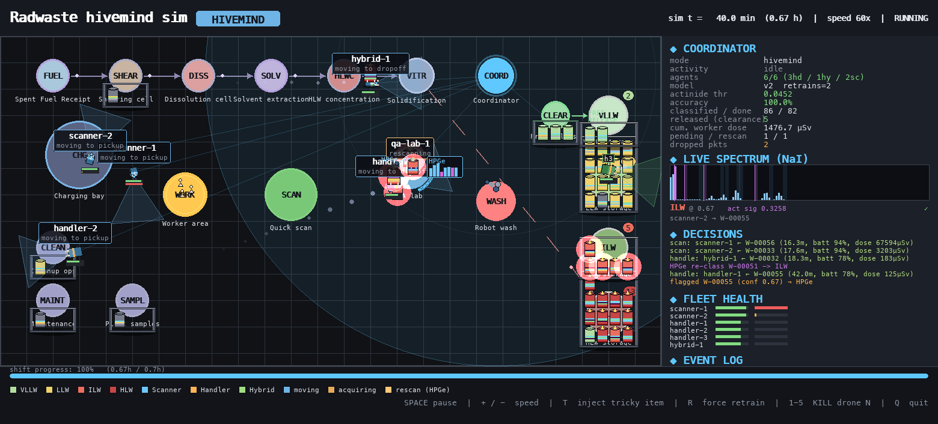
A working facility-scale simulation. Runnable on a laptop.
03
HORUS is not a slide deck. It is a multi-agent simulation of a simplified PUREX reprocessing line — Fuel Receipt → Shearing → Dissolution → Solvent Extraction → HLW Concentration → Solidification — with a fleet of five robotic agents sorting drums into VLLW / LLW / ILW / HLW storage.
We model real gamma physics (Co-60, Cs-137, Am-241, U-235/238, Pu-239), real detector response (NaI 7% FWHM, HPGe 0.2% FWHM at 1332 keV), inverse-square dose accumulation, battery drain, and robot decontamination cycles.
Two modes — ISOLATED (agents act alone) and HIVEMIND (agents share a coordinator) — run side by side on the same seed, on the same drums, to make the architectural claim falsifiable.
Proof of concept
* See the live demo running alongside this deck.

Slide 5
One central memory. One number that matters.
04
Every field report — gamma spectrum, camera frame, confidence, location, dose accumulated — lands in a single ledger. The coordinator's job is not deep learning. Its job is to derive one discriminating scalar — the actinide-spike threshold — from a handful of authoritative HPGe lab labels.
When a new agent comes online, it inherits the threshold instantly. When the threshold drifts — a new feed composition, a new packaging vendor — the coordinator retrains and pushes a new snapshot in seconds.
One number. One ledger. One source of truth. Auditable enough for a regulator to read line by line.
The coordinator
* In the live demo: model version v0 → v2, actinide threshold derives from None → 0.045 over the first 20 minutes of operation.

Slide 6
NaI + camera + dose meter + the inherited threshold.
05
The field agents
Each mobile agent carries:
• A 2"×2" NaI(Tl) gamma spectrometer (~7% FWHM at 662 keV)
• A lightweight camera + ML head for container packaging
• An integrating dose meter for self-protection
• A local copy of the coordinator's learned threshold
Low-confidence calls and disagreements between sensors get flagged. Flagged drums travel to the fixed HPGe lab for authoritative re-classification — and those new labels feed the next coordinator retrain.
Real robots in a hot cell don't run forever. We model that:
• Battery drains during work, recharges in the bay
• Cumulative dose accumulates inverse-square near hot items
• At 5 mSv the agent must visit decon
• At 50 mSv it permanently fails
When an agent goes down, the hivemind's shared task queue routes its drums to surviving agents. Single-agent classification cannot recover from this — its work simply stops.

Slide 7
A masquerading ILW drum, caught in milliseconds.
06
Watch the live demo. A drum arrives at the Cleanup-ops generation point. Its surface dose rate reads LLW. Its NaI gamma spectrum, by gross activity, says LLW. Computer vision says the packaging is LLW. Three sensors, one wrong answer.
ISOLATED MODE — the agent obeys the rules engine. The drum is dropped at LLW storage. Workers on inspection rounds get inverse-square cooked. The mistake compounds.
HIVEMIND MODE — the same agent runs the coordinator's learned threshold on the actinide photopeak windows. The threshold fires. The drum is escalated to ILW and routed via the HPGe lab for confirmation. The hivemind learned this exact trick yesterday, from one HPGe re-class, and every agent now knows it forever.
The decisive moment
* Press T in the live demo to inject a tricky drum and watch it happen in real time.

Slide 8
82.7% → 97.8% accuracy. 15 → 0 ILW misroutes. Dose down 32%. Throughput flat.
07
Results
metric | isolated | hivemind
classification acc | 82.7% | 97.8%
worker dose (µSv) | 7131 | 4841
drums completed | 92 | 95

Slide 9
What runs today. What a pilot adds.
08
Grounded, not promised
REAL TODAY (in the running simulation)
• Real gamma physics: Co-60, Cs-137, Am-241, U-235/238, Pu-239 lines and intensities from public nuclear data
• NaI / HPGe resolution, Poisson counting statistics, inverse-square dose and detector geometry
• Two-tier classifier: auditable rules engine + one learned scalar
• Federated retrain loop and per-agent snapshot delivery
• Robot battery, integrated dose, decon, permanent-failure model
• Side-by-side ISOLATED vs HIVEMIND runs to falsify the claim
PRODUCTION ROADMAP (what a pilot adds)
• ROS 2 / DDS for actual robot comms (vs in-process Python)
• OPC UA bridge to plant I&C systems
• Data diode between safety-class and conventional sides (IEC 60709 / IEC 62859)
• Redundant hot-standby coordinator
• Safety-class qualification for any decision used in regulatory documentation (IEC 61513, IEEE 7-4.3.2, RG 1.152)
• Full HPGe cryostat handling and ANSI N42.14 QA

Slide 10
What HORUS opens up — and who we owe.
09
Thanks to the Hackatom organizers for putting this problem in front of a hackathon, to the judges for the time, and to ENSDF / IAEA whose gamma tables and class boundaries we leaned on hard.
HORUS shipped on one weekend with one trained discriminator. Open questions we'd love to argue about:
• ADVERSARIAL DRUMS — what breaks when a packaging vendor changes geometry?
• THRESHOLD DRIFT — how fast must we retrain across feed chemistries?
• SINGLE-QUEEN FAILURE — smallest hot-standby protocol that survives a corrupted snapshot?
• AUTHORITY BOUNDARY — where does advisory ML end and safety-class decision begin?
Come find us.
Thanks
Team Pantomath · Egypt · ahmedfathy075@gmail.com · try it: python run_demo.py

